Slide 1

Ethics-driven Requirements Engineering A case of Automated Vehicles
Irum Inayat
Senior Lecturer
Interaction Design and Software Engineering

Slide 2
Ethics in RE is both a mindset and a practice
asking questions early: Who benefits? Who might be harmed?
It requires empathy, reflection, and humility, recognizing that technical decisions are never value-neutral.
It shifts the engineer’s perspective from “What works best technically?” to “What serves people best — and justly?”
Embedding ethics in elicitation, analysis, and validation phases.

Slide 3

Towards Ethics-Driven Requirements Engineering Integrating Critical Systems Heuristics & Ethical Guidelines for Autonomous Vehicles
Amna Pir Muhammad, Irum Inayat and Eric Knauss
REFSQ 2025

Slide 4
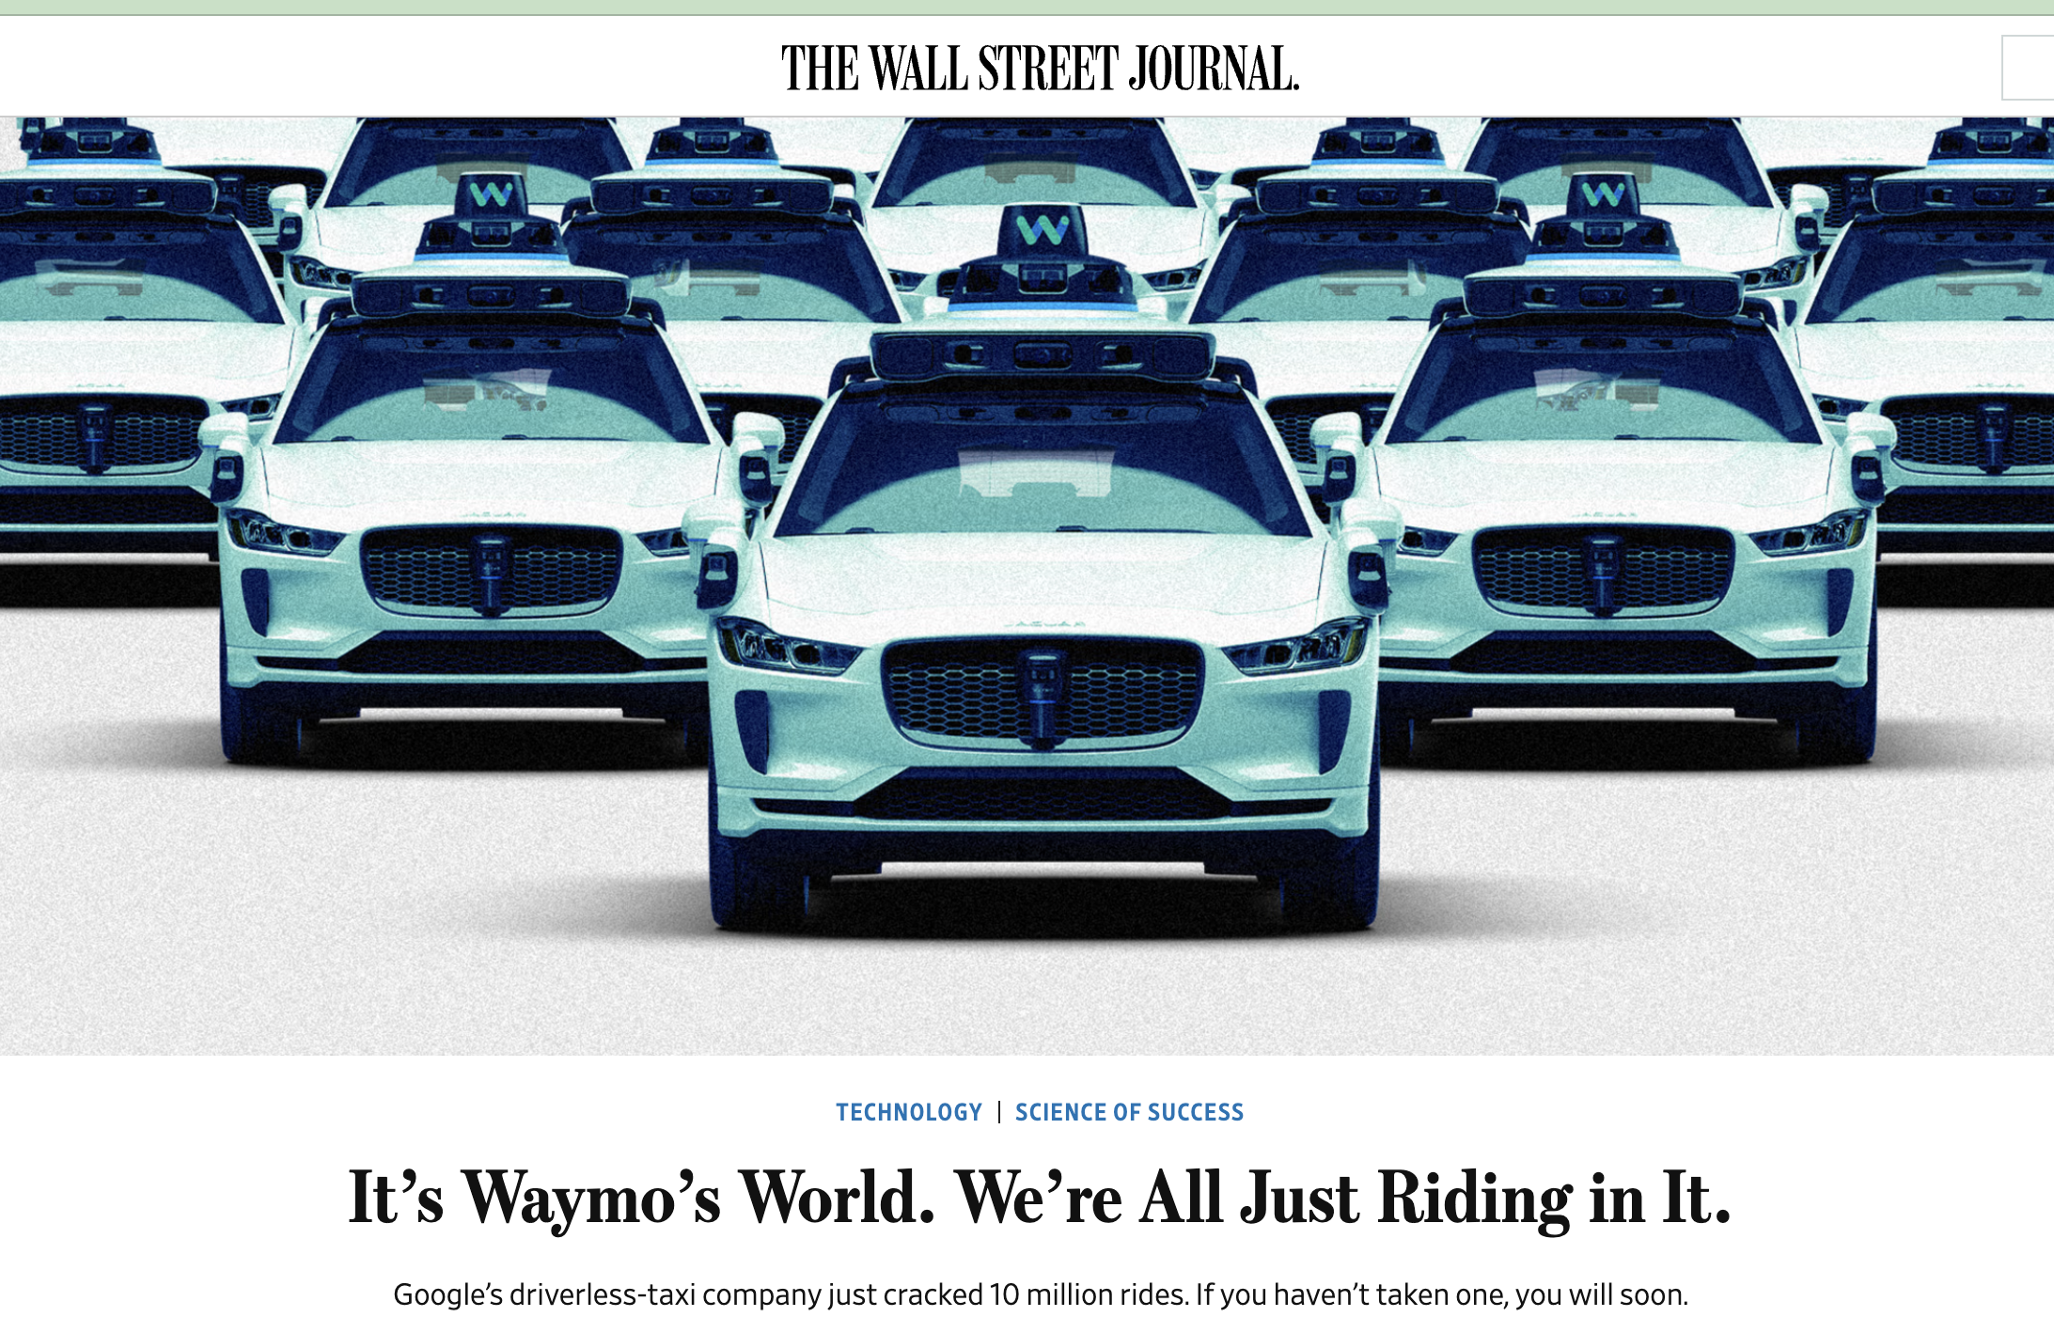
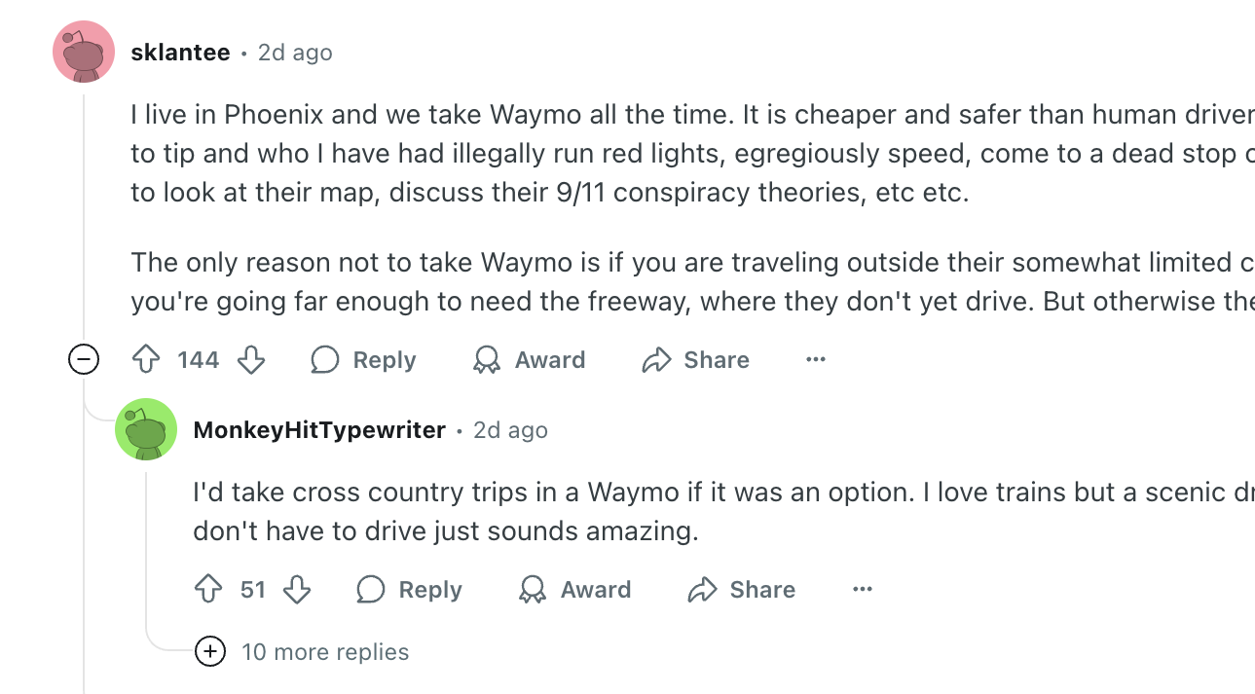
In 2025, Waymo announced a remarkable milestone: its robotaxis had completed over 10 million paid rides
Notes:
https://www.wsj.com/tech/waymo-cars-self-driving-robotaxi-tesla-uber-0777f570?

Slide 5

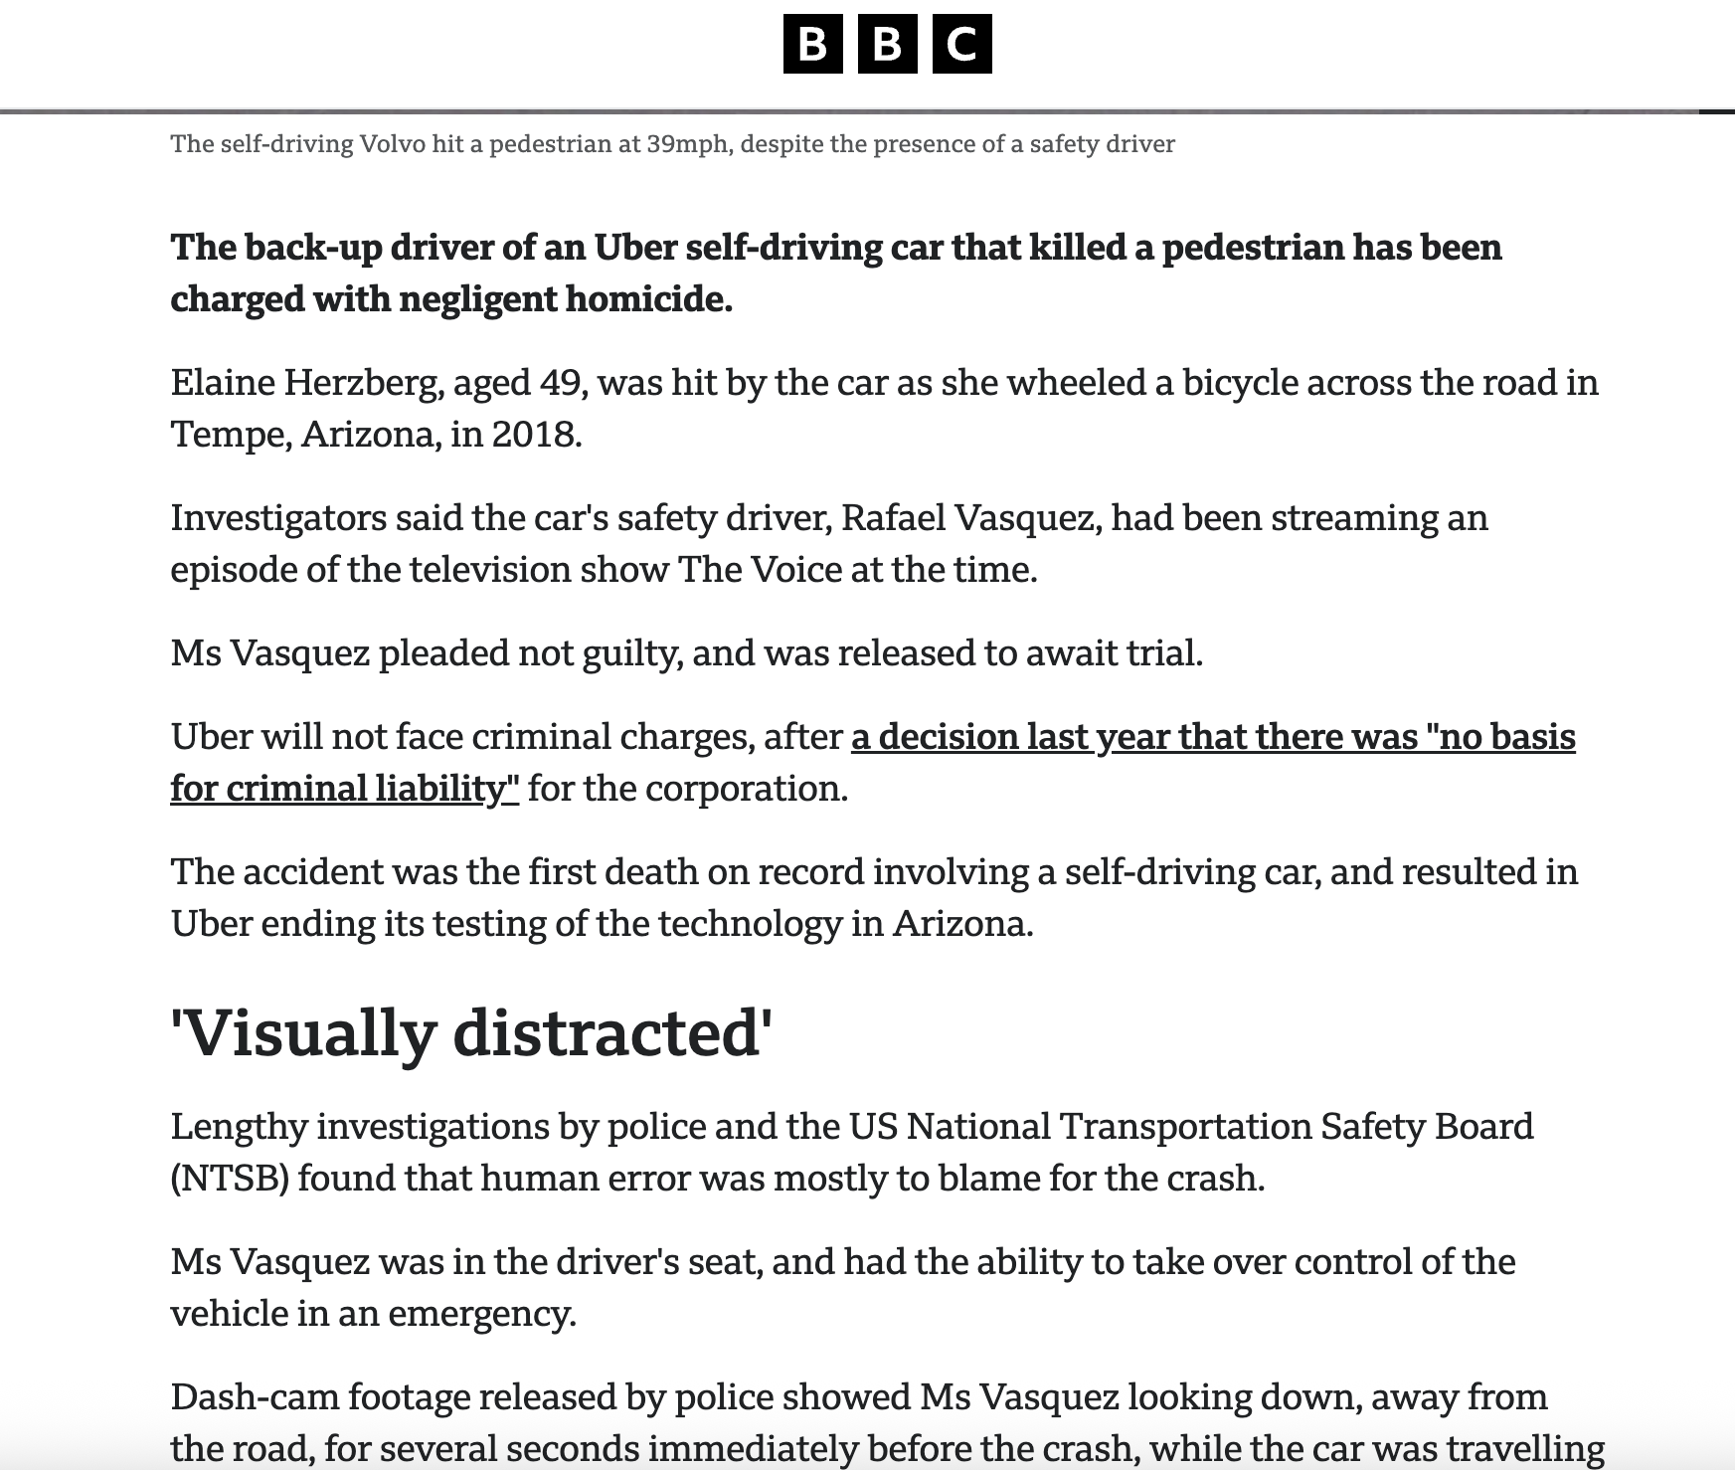

the system worked as designed, but not as ethically expected.
Notes:
In 2018, an autonomous vehicle made a perfectly logical decision, according to its requirements. The only problem? Those requirements forgot to include one small detail: human life outside the crosswalk.”

Slide 6

AV-Ethical challenges
How should a vehicle prioritize decisions in critical scenarios?
What happens when ensuring passenger safety conflicts with pedestrian rights?
Or when inclusion and accessibility require trade-offs in performance or cost?
These questions aren’t just theoretical—they are central to how autonomous vehicles interact with society.

Slide 7

Context
AVs raise complex ethical challenges (e.g. safety, inclusion, societal impact)
Design must go beyond technical performance → address societal values
Lack of practical methods to apply ethical principles in early stages of RE
Notes:
1 AVs are socio-technical systems with significant ethical implications
2 Common ethical challenges: safety, inclusivity, and transparency
3 Need for systematic ethical guidance in RE

Slide 8
Research Problems
How can we support ethics-aware requirements engineering for AVs?
How to identify and include diverse stakeholders?
How to surface hidden assumptions?
How to translate abstract ethical values into system requirements?
“A simplistic persona can’t capture the real lived experience of someone who is blind, someone who has faced lifelong discrimination, or someone with only intermittent access to electricity.”-Birgit Penzenstadler M. Borg et al., "Responsible Requirements Engineering in a VUCA World [Requirements]" in IEEE Software, vol. 42, no. 05, pp. 16-20, Sept.-Oct. 2025, doi: 10.1109/MS.2025.3578176.
Notes:
How can we meaningfully integrate ethical reasoning into RE?
How to identify and include diverse stakeholders?
How to surface hidden assumptions?
How to translate abstract ethical values into system requirements?

Slide 9

Background–Ethical Framework
Ethical Framework (Guizzardi et al.)
Principles: Fairness, Transparency, Accountability, etc.
Applied to system-level requirements in AI/Avs
Critical Systems Heuristics (CSH) (Ulrich & Reynolds)
12 boundary questions
Focused on stakeholder perspectives and assumptions
Notes:
Ethical principles: explicability, autonomy, justice, beneficence, nonmaleficence
RE-centric ethics grounding for AI systems
CSH
Developed by Ulrich & Reynolds
Uses 12 boundary questions to surface assumptions
Emphasizes stakeholder analysis and legitimacy of design decisions

Slide 10
Idea…CSH questions X ethical principles → actionable requirements
Ethical Framework → High-level principles
CSH → Practical reflection and critique tools
Together they
Bridge principles …
Capture ethical blind spots
Empower marginalized voices in RE
CSH
Ethical framework
1. Diverse stakeholders,
2. System boundaries
3. Ethics aware requirements
Notes:
CSH identifies direct and indirect stakeholders
Ethical values guide what should be prioritized
Ethical Framework → High-level principles
CSH → Practical reflection and critique tools
Together they
Bridge principles …
Capture ethical blind spots
Empower marginalized voices in RE

Slide 11
CSH [Q6] What conditions of success are/ought to be outside the decision-maker’s control?
explicability
it emphasizes the need to clearly communicate external dependencies, such as unpredictable pedestrian behavior or adverse weather conditions, to ensure stakeholders understand system limitations.
Justice
it highlights how external conditions could disproportionately affect certain groups, such as pedestrians in areas with poor infrastructure, prompting considerations for fairness in system design.
nonmaleficence
it identifies safety-critical factors, such as potential system failures caused by unanticipated environmental changes, ensuring that mitigations are prioritized.

Slide 12
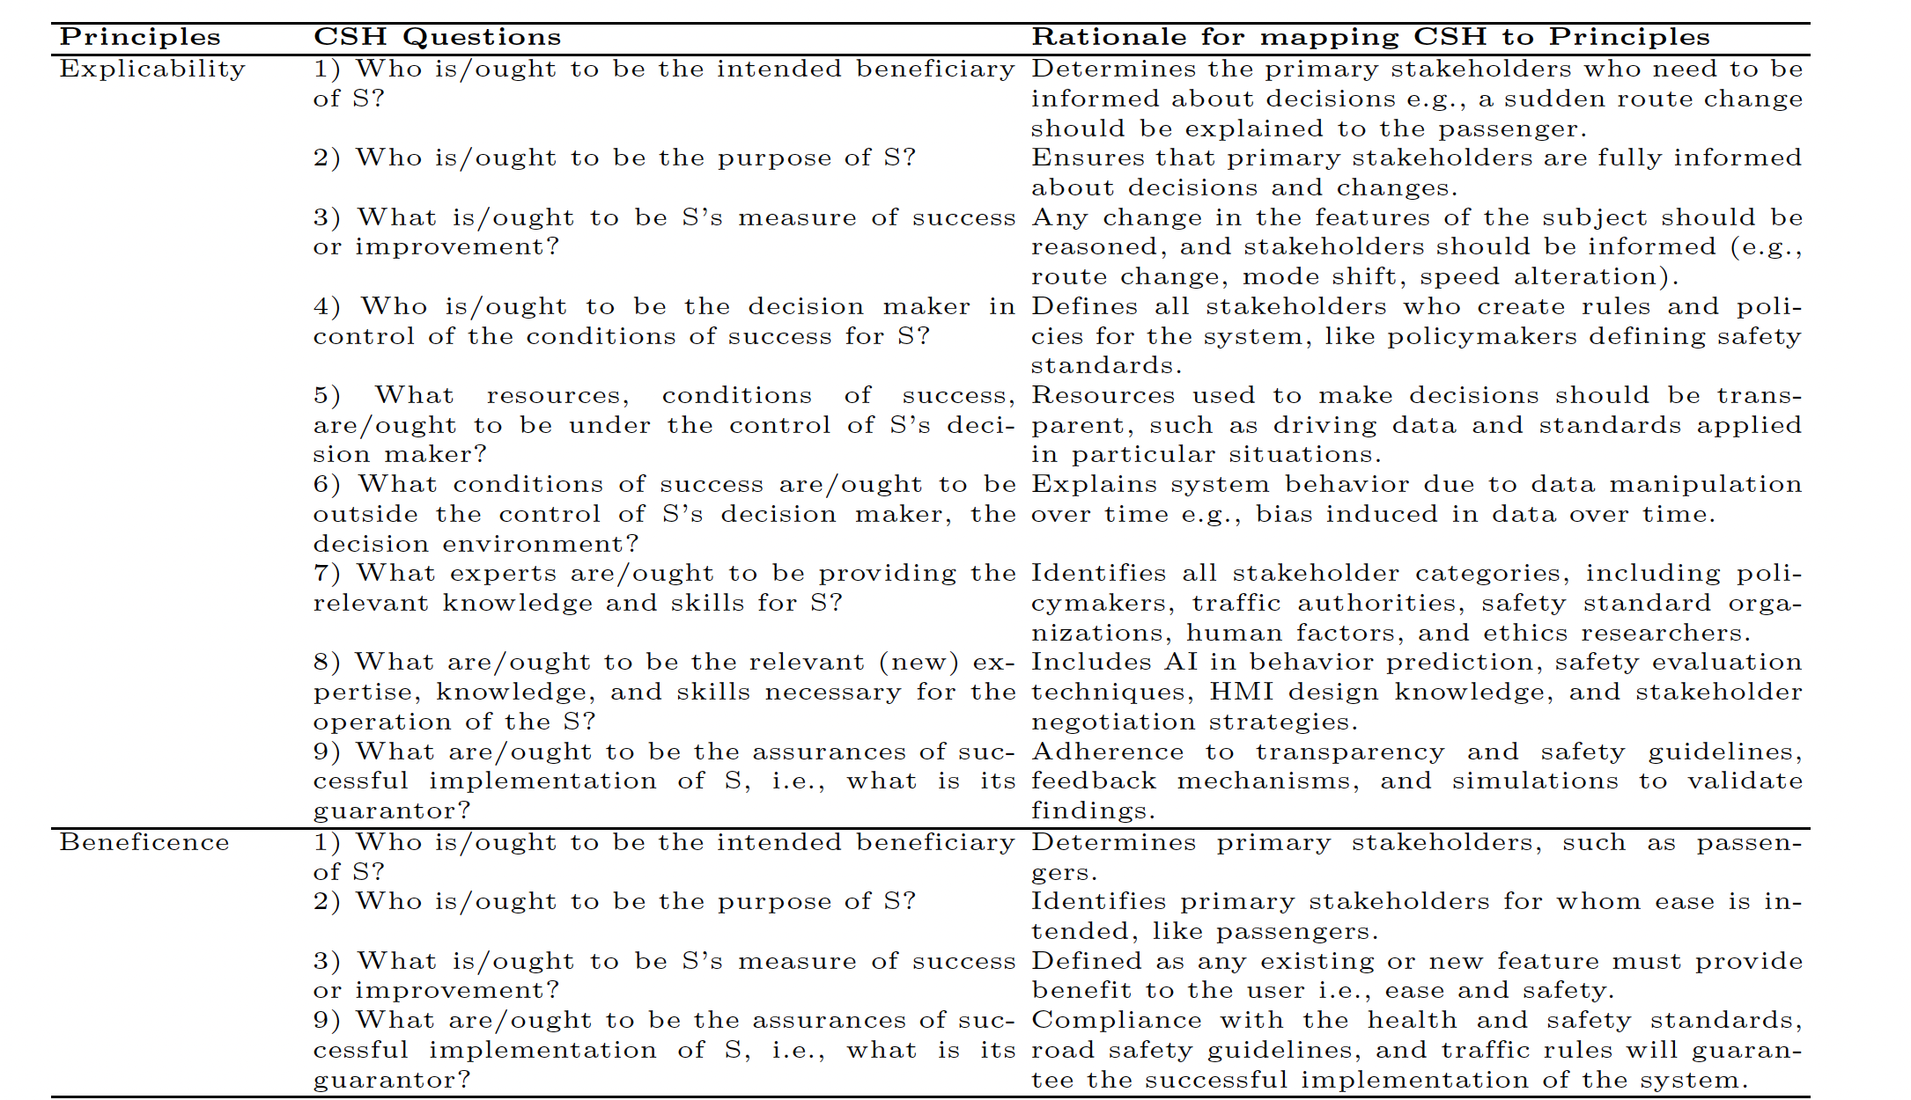
Mapping

Slide 13
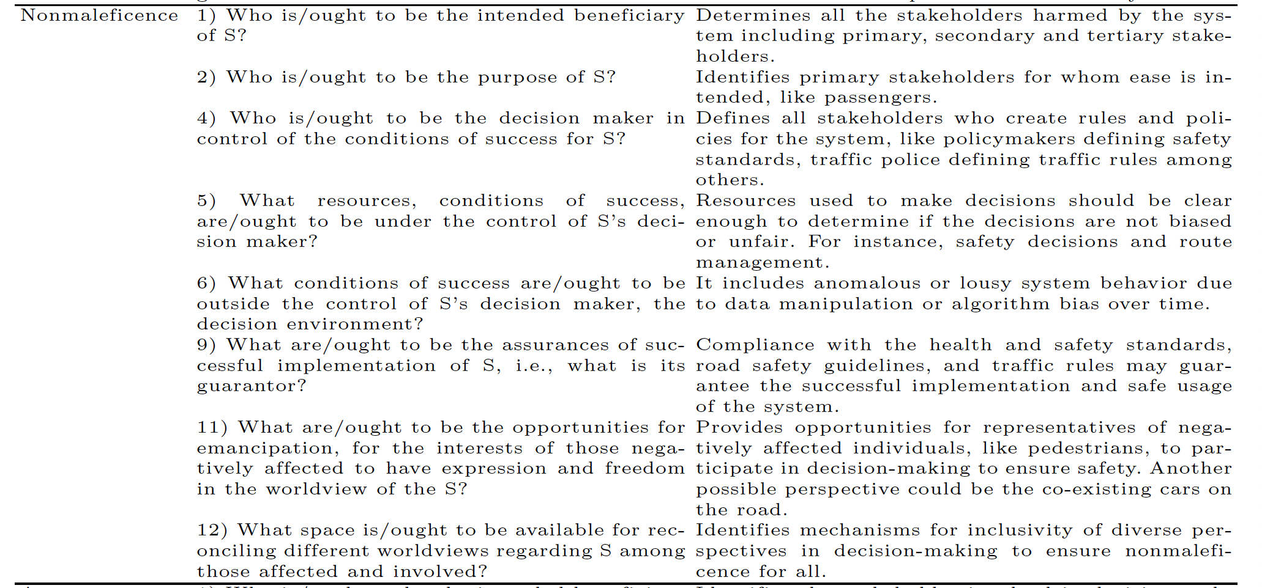
Mapping

Slide 14
Why Ethics in Requirements Engineering?
Requirements are value-laden and every decision reflects moral choices.
Notes:
• Ethical lapses at requirements level can lead to harm, exclusion, or bias.
• Growing need for ethics-aware software, especially in AI and data-driven systems.

Slide 15

Example Scenario Autonomous Vehicle Safety vs. Explainability
Mode A – Maximal Safety, Black Box The AV uses highly optimized algorithms to minimize overall risk, but the decision-making process is opaque — neither passengers, pedestrians, nor regulators fully understand how choices are made.
Mode B – Transparent Decisions, Slightly Higher Risk The AV provides explainable reasoning for every maneuver or ethical decision (e.g., in unavoidable accident scenarios), but its overall risk minimization is slightly less optimal.

Slide 16
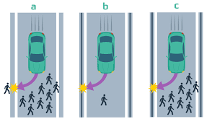
Example
Ethical issues in Automated Vehicles
Ethical requirements
Ways to validate

Slide 17

1. Ethical Issues:
Issue 1: Bias in pedestrian detection (e.g., poorer recognition for certain body types or clothing).
Issue 2: Decision-making in unavoidable crash scenarios (e.g., who should the car prioritize?).
2. Ethical Requirements:
ER1: The AV shall be trained and validated on diverse datasets to ensure fair pedestrian recognition across demographics.
ER2: The AV shall record decision logs and provide post-incident explanations of its ethical reasoning.

Slide 18

Ethical tension
Safety vs. Fairness: Optimizing for overall safety may still disadvantage certain groups (e.g., cyclists, children, or pedestrians in low-visibility conditions).

Slide 19

Validation Discussion:
Fairness could be tested by simulation with diverse pedestrian datasets.
Ethical decision logging could be validated through scenario-based testing and explainability audits.

Slide 20

Class Task [10-15 mins]
You will work in pairs.
Turn to the person sitting next to you or go find a partner
Think about social media as your domain
Your job is to:
1. Identify two potential ethical issues.
2. Suggest ethical requirement(s) relevant to the ethical issues.
3. mention an ethical tension in the domain
Discuss: How could these be verified during validation?

Slide 21
Challenges in Ethical RE
• Conflicting stakeholder values and priorities.
• Lack of formal methods for specifying ethical concerns.
• Difficulties in measuring ethics-driven qualities.
• Risk of 'ethics washing' — claiming ethical alignment without real action.

Slide 22
Best Practices for Ethics-driven RE
• Include ethicists and social scientists in early RE phases.
• Use scenario-based reflection and stakeholder mapping.
• Maintain traceability between ethical principles and system requirements.
• Combine qualitative and quantitative evaluation of ethical aspects.

Slide 23
Takeaways
• Ethical RE = making moral values explicit in requirements.
• Early ethical reflection reduces harm and increases societal trust.
• Frameworks like CSH and Ethical Impact Assessment provide structure.
• Ethics in RE is both a mindset and a practice.

Slide 24
References
[1] A. Pir Muhammad, I. Inayat, and E. Knauss, “Towards Ethics‑Driven Requirements Engineering: Integrating Critical Systems Heuristics and Ethical Guidelines for Autonomous Vehicles,” in Requirements Engineering: Foundation for Software Quality (REFSQ 2025), Springer, 2025.
[2] W. Ulrich and M. Reynolds, Critical Systems Heuristics. Wiley, 2020.
[3] K. Spiekermann, Ethical IT Innovation, Springer, 2016.
[4] M. Thew and A. Sutcliffe, 'Value-based Requirements Engineering,' IEEE RE, 2018.

